Slide 1
Software Quality Assurance

Slide 2
Unit V : Software Quality Assurance Software Quality, Achieving Software Quality: Software engineering methods, Project Management techniques. Quality control and quality assurance. Software Reliability, SQA Tools, Goals and Metrics, Introduction to Software Process Standards: ISO, CMMI, PCMMI.
Introduction to Software Testing, Principles of Testing, Testing Life Cycle, Phases of Testing, Types of Testing, Verification & Validation, Defect Management, Defect Life Cycle, Bug Reporting, GUI Testing, Test Management and Automation.

Slide 3
Software Quality
Software Quality Assurance is simply a way to assure quality in the software.
Software quality assurance is a process which works parallel to development of software

Slide 4
Software Quality Assurance
SQA is a set of activities for ensuring quality in software engineering process.
That ultimately result in the quality of software products..
The SQA is a process in which conformed to the requirement of the product is met.
Process that ensures that developed software meets and complies with defined or standardized quality specification.

Slide 5
SQA Activities
The SQA activities associated with ..
Software Engineering processes (Requirement analysis, system design, implementation, testing, deployment and maintenance)
Responsible for developing the product
SQA Group:
Responsible for performing quality assurance planning over sight, record keeping analysis and reporting.

Slide 6
SQA Activities
These activities are:
Process defining and implementation
Auditing
Training

Slide 7
These processes could be:
Software development methodology
Project Management
Configuration Management
Requirement development/management
Estimation of cost and time
Software design and testing

Slide 8
After processes completion SQA has following responsibilities:
Identify weakness in the processes
Correct those weaknesses to continually improve the process

Slide 9
How SQA is beneficial?
SQA produces high quality software.
High quality application saves time and cost
Better reliability and no maintenance for long time
High quality commercial software increase market share of company

Slide 10
Software Quality
Depends on lots of factors…
Fulfil customer’s requirement:
It should do what customer want from it
It should provide all those feature for which software was developed
Looks Good..
Software design should be good
Attractive colours should be used
Fonts should be attractive and easy to understand.

Slide 11
Maintainability:
Software should be maintainable
If some area of software gets defected working of other parts should not be disturbed too much
Software should have good fault tolerance.

Slide 12
Value for money
Ask question to yourself “Is the software value for money”
Is it saving the time?
Is it saving the money in any sense?
Is it making the company/organization grow faster?
Organization’s Graph:
Compare the organizations growth graph before and after use of this software

Slide 13
SQA Activities
Must perform SQA activities
1. SQA Management Plan
Make a plan how you will carry out the SQA through out the project
Think which set of software engineering activities are the best for the project
Check the level of SQA teams skills

Slide 14
2. Set the check points
SQA team should set check points
Evaluate the performance of the project on the basis of the collected data on different check points
Eg: Review check point, inspection check point

Slide 15
3. Multi testing strategy:
Do not depends on a single testing approach.
When you have lots of testing approaches available, use them.
Be strict to make correction and retest the correction.

Slide 16
4. Measure change impact:
The changes for making the correction of an error some times are introduces more errors keep he measure of impact of change on project.
Retest the new change to check the compatibility of this fix with whole project.

Slide 17
5. Manage good relations:
Yes, in the working environment managing the good relations with other teams involved in the project development is mandatory.
Bad relations of SQA team with programmers team will impact directly and badly on project.
Avoid politics

Slide 18
Quality Assurance:
It check if the implemented techniques and approaches are good to assure quality in software.
It also finds the approaches, techniques to assure the quality in software.
It deals with the process used to develop the software and try to assure the quality by selecting the quality process, approach and technique.
Its all about the process and techniques to assure the quality.

Slide 19
Quality Control
Quality control is the process in which we verify if we achieved the required quality by applying all the process or not.
It is the process after the SQA process mostly.
It also check if all the processes required to achieve and assure the quality are implemented correctly.
It checks he product we got by following the approaches and try to fix the bugs and defects as well

Slide 20
Quality Assurance Vs Quality Control
 | Quality Assurance | Quality Control
Definition | QA is a set of activities for ensuring quality in the processes by which products are developed | QC is a set of activities for ensuring quality in products. The activities focus on identifying defects in the actual product produced
Focus on | QA aims to prevent defects with a focus on the process used to make the product. It is proactive quality process | QC aims to identify defect in the finished product. Quality control, therefore, is a reactive process.

Slide 21
 | Quality Assurance | Quality Control
Goal | The goal of QA is to improve development and test processes so that defects do not arise when the product is being developed. | The goal of QC is to identify defects after a product is developed and before its released
How | Establish a good management system and the assessment of its adequacy. Periodic conformance audits of the operations of the system | Finding and eliminating sources of quality problems through tools and equipment so that customer’s requirements are continually met

Slide 22
 | Quality Assurance | Quality Control
What | Prevention of quality problems through planned and systematic activities including documentation | The activities or techniques used to achieve and maintain the product quality, process and service
Responsibility | Everyone on the team involving in developing the product is responsible for quality assurance | Quality control is usually the responsibility to a specific team that test the product for defects.

Slide 23
 | Quality Assurance | Quality Control
Example | Verification is an example of QA | Validation/software testing is an example of QC
Statistical technique | Statistical tools and techniques can be applied in both QA and QC, when they are applied to process they are called statistical process control (SPC) and becomes the part of QA | When statistical tools and techniques are applied to finished products, they are called as statistical quality control (SQC) and comes under QC, and comes under QC.
As a tool | QA is a managerial tool | QC is a corrective tool

Slide 24
Software Quality Metrics

Slide 25
Classified into three categories
Product metrics − Describes the characteristics of the product such as size, complexity, design features, performance, and quality level.
Process metrics − These characteristics can be used to improve the development and maintenance activities of the software.
Project metrics − This metrics describe the project characteristics and execution.
Examples include the number of software developers, the staffing pattern over the life cycle of the software, cost, schedule, and productivity.

Slide 26
Software quality metrics focus on the quality aspects of the product, process, and project.
These are more closely associated with process and product metrics than with project metrics.
Software quality metrics can be further divided into three categories
Product quality metrics
In-process quality metrics
Maintenance quality metrics

Slide 27
Product Quality Metrics
This metrics include the following −
Mean Time to Failure
Defect Density
Customer Problems
Customer Satisfaction

Slide 28
Mean Time to Failure
It is the time between failures. This metric is mostly used with safety critical systems such as the airline traffic control systems, avionics, and weapons.
Defect Density
It measures the defects relative to the software size expressed as lines of code or function point, etc. i.e., it measures code quality per unit.
This metric is used in many commercial software systems.

Slide 29
Customer Problems
It measures the problems that customers encounter when using the product.
It contains the customer’s perspective towards the problem space of the software, which includes the non-defect oriented problems together with the defect problems.
The problems metric is usually expressed in terms of Problems per User-Month (PUM).

Slide 30
PUM = Total Problems that customers reported (true defect and non-defect oriented problems) for a time period
+
Total number of license months of the software during the period
Where,
Number of license-month of the software=
number of install license of the software * number of months in
the calculation period

Slide 31
Customer Satisfaction
Customer satisfaction is often measured by customer survey data through the five-point scale −
Very satisfied
Satisfied
Neutral
Dissatisfied
Very dissatisfied

Slide 32
Satisfaction with the overall quality of the product and its specific dimensions is usually obtained through various methods of customer surveys.
Based on the five-point-scale data, several metrics with slight variations can be constructed and used, depending on the purpose of analysis. For example −
Percent of completely satisfied customers
Percent of satisfied customers
Percent of dis-satisfied customers
Percent of non-satisfied customers
Usually, this percent satisfaction is used.

Slide 33
ISO
ISO: It applied to any ty of industry
CMM: Specially designed for software industry
ISO 9000 addresses cooperate business process
CMM: Focuses on software engineering activities
ISO 9000 specifies minimum requirements
CMM: gets into technical aspects of software engineering
ISO 9000 provides pass of fail criteria
CMM: Provides grades
ISO9000 has no levels
CMM has five levels

Slide 34
Software Process Standards
Process improvement model.
Process is an set of activities that an organization does. Holding organizations people and technology.
CMM applied to the areas of Development, services, and acquisitions.
Development: Companies which manufactures products
Services: service sector
Acquisition: companies which are in outsourcing
Structure of CMM

Slide 35
CMM : Capability Maturity Model
Level 1: Processes are unpredictable, poorly controlled, reactive.
Level 2: Processes are planned, documented, performed, monitored and controlled at the project level, often reactive. Every project follows some standard.
Level 3: Processes are well characterized and understood, Processes, standards, procedures, tools etc are defined at organizational level. Proactive.
Level 4: Processes are controlled using statistical and other quantitative techniques. (Quantitatively managed level)
Level 5: Processes performance continually improved through incremental and innovative technological improvements

Slide 36
People Capability Maturity Model
It is a maturity framework that focuses on continuously improving the management and development of the human assess of an organization.
It describes an evolutionary improvement path from ad hoc, inconsistently performed practices, to a mature, disciplined, and continuously improving development of the knowledge, skills, and motivation of the workforce that enhances strategic business performance.

Slide 37
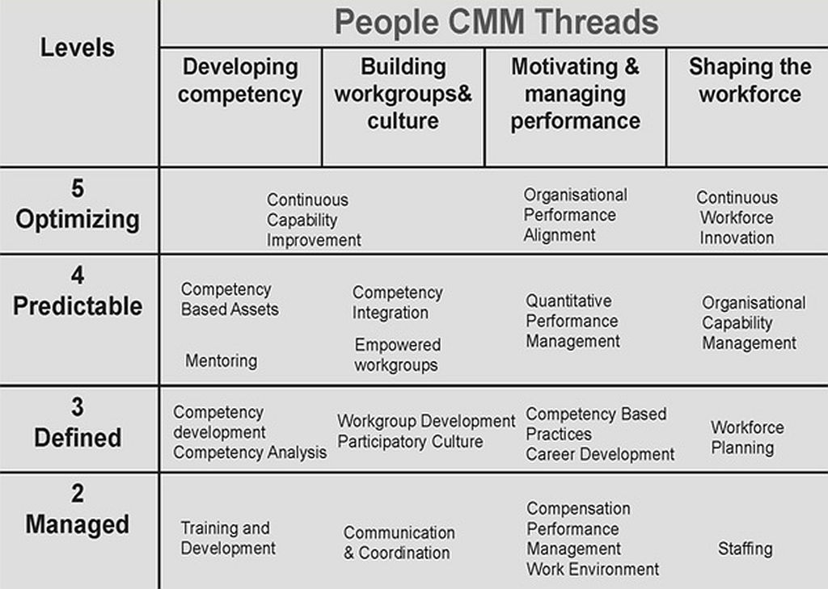

Slide 38
Structure
The People CMM document describes the practices that constitute each of its maturity levels and information on how to apply it in guiding organizational improvements.
It describes an organization's capability for developing its workforce at each maturity level.
It also describes how the People CMM can be applied as a standard for assessing workforce practices and as a guide in planning and implementing improvement activities.

